Slide 1

Welcome to Year 1

Slide 2
The Year One Team:
Teachers: Mrs Badham (Monday – Wednesday)
Mrs Black (Thursday – Friday)
Teaching Assistant: Miss Smith

Slide 3
Transition from Reception into Year 1
Behaviour
Independence
National Curriculum subjects

Slide 4
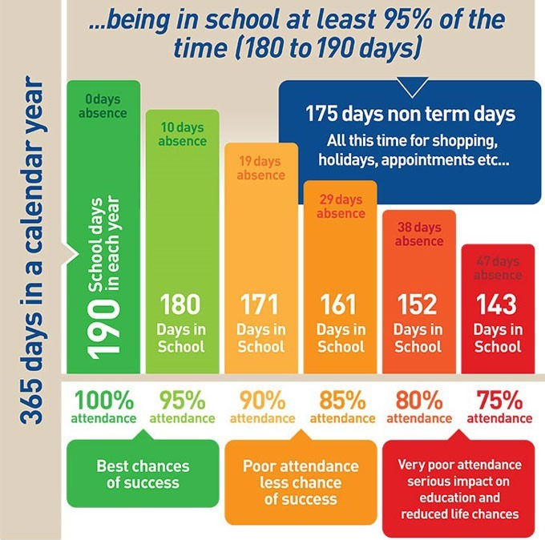
Absence
admin@st-francisxaviers.hereford.sch.uk
In year 1 the children are taught in small steps, missing one or more of these can hugely affect their understanding.

Slide 5
Contacting us
admin@st-francisxaviers.hereford.sch.uk
Seesaw

Slide 6
The importance of reading:
The biggest impact on the children’s learning is reading. Please aim to read every evening for about 10 minutes. If your child is tired then read to them – it all helps.

Slide 7
Phonics:
We follow RWI phonics to help teach the children to read and write. Please prioritise reading these books as they will have the biggest impact.
Red words – cannot be sounded out
Any words in black can be sounded out
eg: sh-e-d, b-e-n-ch, c-l-ay, th-u-n-d-er

Slide 8
Froggy Maths
Helps the children’s mental maths skills and quick recall of key number facts. If you are practising at home please practise the skills and try not to help the children simply learn the order of the answers – it doesn’t help their math skills.

Slide 9
Learning logs:
We will send the learning logs home at least once a half term with an activity for you to help your child with. Please do support your child with these tasks and send them back in time so we can share them as a class.

Slide 10
Thank you for coming!
Any questions?

