Slide 1
Teaching for Mastery
At St. Francis Xavier’s R.C. Primary

Slide 2
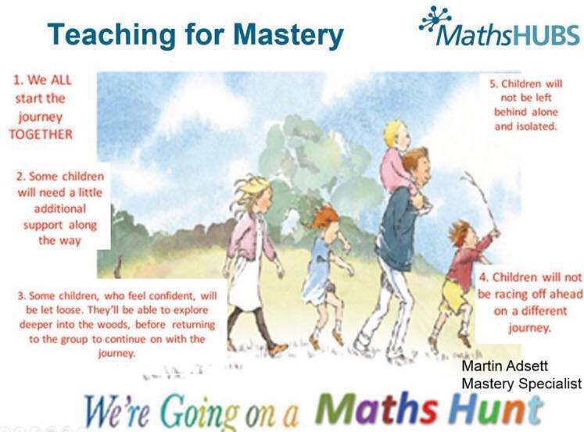

Slide 3
Stage 1
Use of C-P-A approach
Concrete-Pictorial-Abstract
Ensuring use of pictorial representations
Embedding reasoning both in book work and class discussion
Use of stem sentences- verbalising thinking. Learning from mistakes.
A journey towards Teaching for Mastery at S.F.X.

Slide 4
Stage 2
Developing Fluency- teaching strategies
Recall of facts AND variation in methods.
Consistent use of Bar modelling- developing our children’s confidence in problem solving.
Addressing misconceptions- same day interventions

Slide 5
Stage 3
Ongoing CPD for staff- insets + staff meetings
Sharing mastery practice- with colleagues, parents, TAs.
Embed Mastery techniques such as What it is/what it is not
What is the same, what is different?
A useful struggle- building resilience
Different representations
Small steps planning- mapping the journey of a lesson.
Ensuring less pace and race
Deepening understanding
Use of working wall

Slide 6
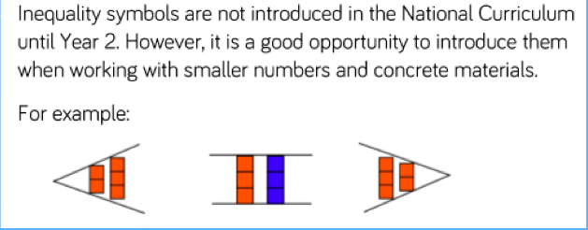
In Shanghai textbooks, models are commonplace.

Slide 7
What did we learn from Shanghai?
Too often, as a nation we have focussed on procedural understanding (the how to do calculations) rather than the conceptual understanding. This is a worldwide problem.
Maths mastery seeks to develop conceptual understanding (the why am I doing this?) and develop connections- it is all about making connections when learning. “I know this, so...”

Slide 8
What do we mean by Mastery?
Deep and sustainable learning – for all
  Depth is the key to avoiding the need to repeat teaching.
  It doesn’t feel like we’re starting again each term.
The ability to build on something that has already been sufficiently mastered
  …for this stage of learning - Mastery is a continuum
Notes:
What does it mean to ‘teach for mastery’?
Mastery for all – not just the most able as originally put forward by the DfE.

Slide 9
What do we mean by Mastery?
The ability to reason about a concept and make connections
    Cuts down on the amount I need to learn
    eg relating concepts of division, fractions and ratio
    Deepens conceptual understanding.
Conceptual and procedural fluency
  Move maths from one context to another. Recognise concepts in unfamiliar situations.
  Know number facts and tables, have efficient procedures

Slide 10
What do we mean by Mastery?
A mastery approach: a set of principles and beliefs. This includes a belief that all pupils are capable of understanding and doing mathematics, given sufficient time. Pupils are neither ‘born with the maths gene’ nor ‘just no good at maths’. With good teaching, appropriate resources, effort and a ‘can do’ attitude all children can achieve in and enjoy mathematics. NCETM

Slide 11

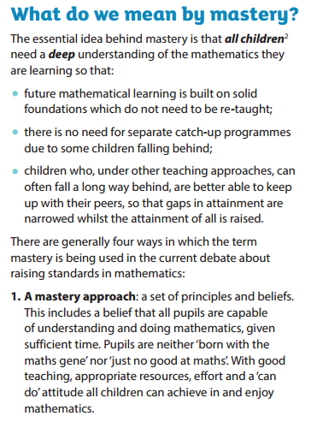
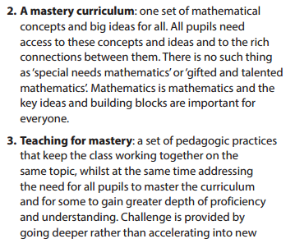
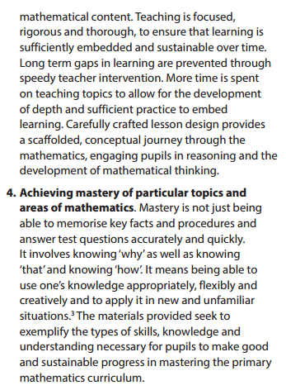
https://www.ncetm.org.uk/resources/46689

Slide 12
One way to develop conceptual understanding is C-P-A
Concrete- using apparatus
Pictorial (including bar modelling)
Leading to deep conceptual understanding of the abstract.

Slide 13
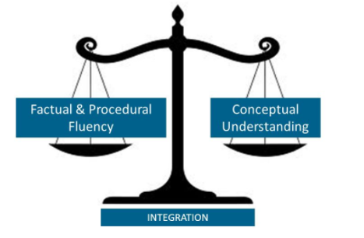
The New Curriculum

Slide 14
The C-P-A approach isn’t about getting the answer quickly and isn’t just for the less able children, its about giving children the tools to understand the problem in front of them. Even when a child has answered the question in the abstract method, it is worth getting them to use concrete manipulatives to convince others that they are correct.
C-P-A is for everyone, mastery teaching encourages the use of concrete manipulatives in any lesson and suggests there is value in the children having a variety of equipment to aid their thinking and deepen their understanding by explaining in different ways.

Slide 15
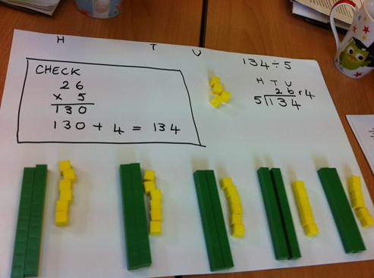
Notes:
Here a child has been asked to solve the calculation 134 / 5, check it and then prove it.

Slide 16
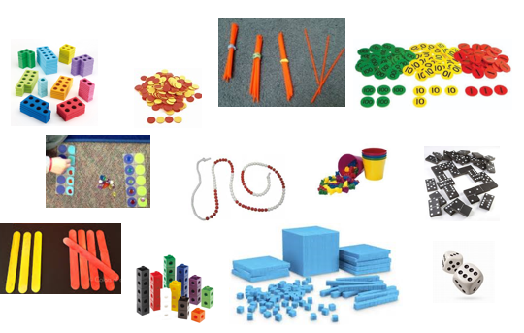
Concrete
Used during the learning of new concepts or when building further onto learnt concepts
It allows teachers to gain a greater understanding of where misconceptions lie and the depth a child exhibits.
Allows children to develop their ability to communicate mathematically and to reason.
It gives children a deep understanding of mathematics
Concrete resources give pupils time to investigate a concept first - and then make connections when formal methods are introduced
Notes:
Explain that the concrete-pictorial-abstract approach is based on Jerome Bruner’s important psychological research. Bruner suggested that pupils need to take three vital steps in order to develop their understanding of a concept. This systematic approach is designed to give pupils the time to make connections, notice mathematical patterns and really understand what’s going on.

Slide 17
How do SFX children use CPA?
We have invested in Maths trolleys in each classroom.
Y5/Y6 use place value discs, fraction models frequently.
Y3 use dienes/place value discs
Y2 bead strings, part/whole models, counters, numicon etc
Numicon throughout the school
Cuisinaire rods
Whiteboards/pens for pictorial

Slide 18
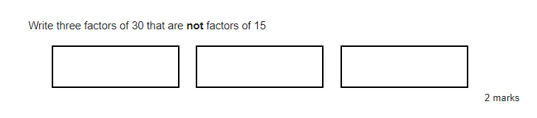
2016 KS2 Maths paper 3
In class the children could answer the question and then prove it using concrete apparatus.

Slide 19





Multiple representations
13 ÷ 4 = 3 remainder 1
Tens | Ones
Notes:
Show your staff the different representations.
(i) Counters shared between 4
Can be done physically with bean bags and hoops or counters and circles. However the grid is ideal for bar modelling (sharing).
(ii) Grouping with place value counters
Start by making the number 13. This could also be done with base 10. Look at the tens: can I make any groups of 4? No, but can I make an exchange? Yes, I exchange one ten for ten ones. I can make 3 groups of 4 with one left over.
(iii) Rods and rulers for repeated subtraction
We want to see how many fours go into 13. Pupils should start at 13 on their rulers and use the Cuisenaire rod that is worth 4. They must always arrive at 0. Three whole fours with 1 left over go into 13.
(iv) Numicon encourage grouping
Start by making the number 13. How many fours go into 13? Place the number four alongside the number 13. Three fours with one left over make 13.

Slide 20
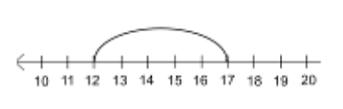
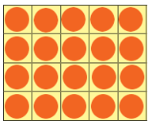
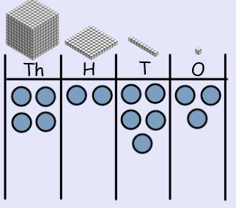
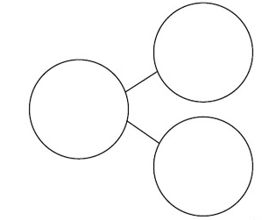
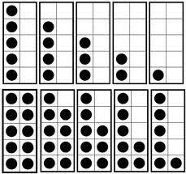
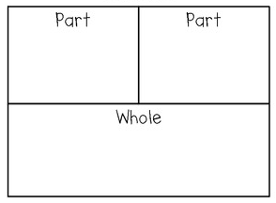
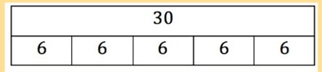
Pictorial
The pictorial stage allows pupils to demonstrate and sustain their understanding of mathematical concepts and processes
Tens frame
Bar model
Part – part whole
Notes:
Explain that the pictorial stage involve the pupils representing the concrete resource or using a bar model to clarify what a maths question actually means.

Slide 21
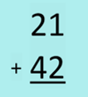
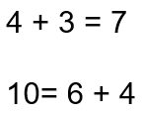
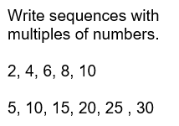
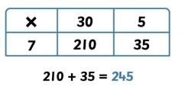
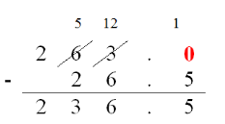
Abstract
The abstract stage should run alongside the concrete - pictorial stage (enables pupils to read mathematical statements and show their understanding using concrete resources or pictorial representations).
Notes:
Give an example for the ‘abstract stage’. For example, when teaching addition, pupils can use or draw base 10 alongside the abstract method (ie formal written columns).

Slide 22
Hundreds Tens Ones 346 + 127 =
3
4
6
100
100
10
10
1
1
1
1
1
1
100
10
10
+
1
2
7
1
1
100
10
10
1
1
1
1
1

Slide 23
Hundreds Tens Ones 346 + 127 =
3
4
6
100
100
10
10
1
1
1
1
1
1
100
10
10
+
1
2
7
1
1
100
10
10
1
1
1
1
1

Slide 24
Hundreds Tens Ones 346 + 127 =
10
3
4
6
100
100
10
10
1
1
1
1
1
100
10
1
1
10
1
1
1
1
1
+
1
1
2
7
6 + 7 = 13
100
10
10
10 + 3

Slide 25
1
473
Hundreds Tens Ones 346 + 127 =
10
3
4
6
100
100
10
10
100
10
10
+
1
2
7
6 + 7 = 13
100
10
10
10 + 3
4
7
3
1
1
1

Slide 26
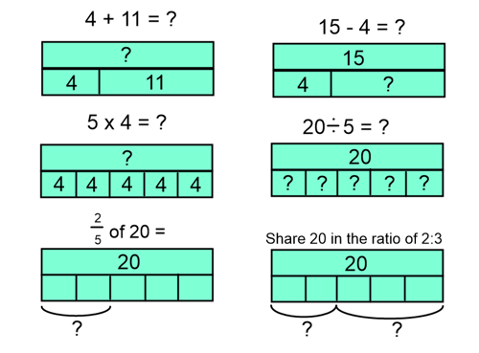
Bar model – a consistent picture
“Bar models are a tool to help
children visualise stories”
Ban Har 2016

Slide 27
Teaching for Mastery
Representation
& Structure
Access
Mathematical Thinking
Chains of Reasoning
Fluency
Number Facts
Variation
Procedural
Conceptual
Table Facts
Pattern
Making Connections
Making Connections
Making Connections
Making Connections
Coherence
Small steps are easier to take
Notes:
A part of mastery Sarah asked to focus on was stem sentences.

Slide 28
Coherence has implications for our planning of a lesson. Put your time and energy into the small steps within a lesson. Don’t let the resource lead the lesson. Let the small steps lead the learning. Powerpoints are a useful planning tool and are used in the lesson. ☺
Small steps. Leave no step out- don’t presume prior knowledge. Start low, but accelerate quickly. Use ping pong ‘write stuff’ style teaching. Bring the class back together regularly through the lesson. Questioning will uncover misconceptions.
Our trays can be used effectively after one/two whole class activities.
Focus on a zone to observe/question for assessment through the lesson. Use marking stations. Encourage children to say why they went wrong. Use thought bubbles for self evaluation/explaining reasoning.
Have whole class mixed-ability paired activity following teaching with different representations and images. Make use of your working wall to keep images/drawings/ideas.
Use stem sentences. E.g. “ten tenths make a whole” to reinforce the main teaching points of a lesson. Repeat them throughout the lesson. Use “I say, you say” cues.
Develop an understanding of what a child who is fluent looks like.
They can demonstrate variation in their methods and show resilience when problem solving.
“I tried method a and it didn’t work so I tried method b.” They are also able to represent their methods using images and diagrams as well as explain their thinking to others. Mistakes are an opportunity to learn something new. “I know where I went wrong- I thought this but I should have thought that.”

Slide 29


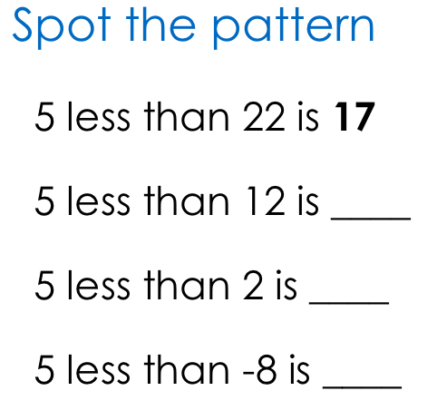
1. What is the same? What is different?
2. Adam says….”When you multiply any number by 10 you just add a zero.” Is he correct?
3. True or false? Dividing by 4 is the same as dividing by 2 twice.
4. Explain how this number fact helps you to solve this
problem. 32+ 64= 96 31+66=
8. Spot the pattern
5. How many ways can you solve…?
6. Position on a numberline…
7. Rank by difficulty
9. Convince me…

Slide 30
The Use of Stem Sentences
The important thing is when these sentences are introduced. They are never introduced for the first time at the beginning of a lesson, but are developed as a summary of what has already been learnt, explored and expressed. They sometimes come from the children who express the mathematics in a helpful way that is then shared with the whole class. The teacher makes the children feel like they came to the sentence naturally, when in fact, the teacher had already planned the sentence stem prior to the lesson.

Slide 31
Expect children to use correct mathematical terminology and to express their reasoning in complete sentences.
The quality of children’s mathematical reasoning and conceptual understanding is significantly enhanced if they are consistently expected to use correct mathematical terminology (e.g. saying ‘digit’ rather than ‘number’) and to explain their mathematical thinking in complete sentences.
I say, you say, you say, you say, we all say
This technique enables the teacher to provide a sentence stem for children to communicate their ideas with mathematical precision and clarity. These sentence structures often express key conceptual ideas or generalities and provide a framework to embed conceptual knowledge and build understanding. For example:
If the rectangle is the whole, the shaded part is one third of the whole.
Having modelled the sentence, the teacher then asks individual children to repeat this, before asking the whole class to chorus chant the sentence. This provides children with a valuable sentence for talking about fractions. Repeated use helps to embed key conceptual knowledge.

Slide 32
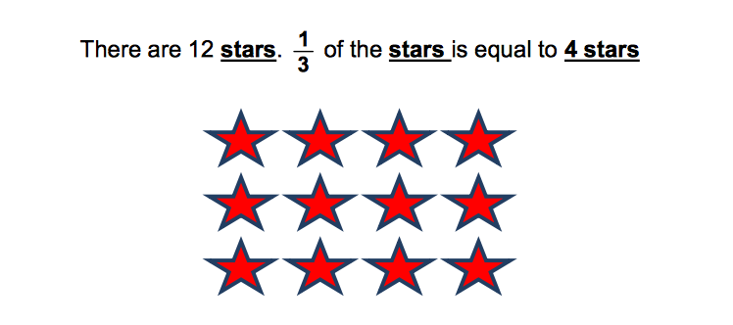
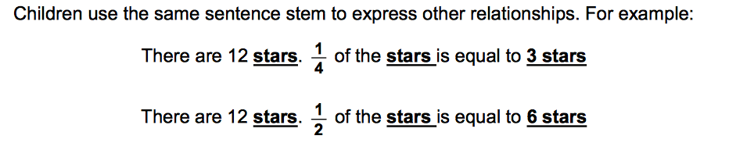

Slide 33
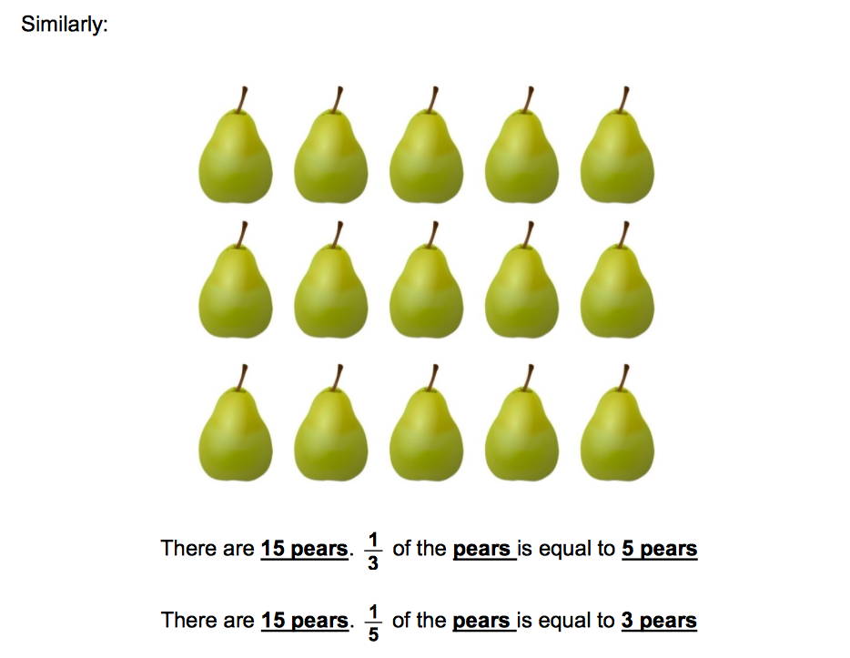
In order for the stem sentences to emerge within the lesson, the practice of answering questions in complete coherent sentences needs to be commonplace.
Children will need sentence stems and mathematical vocabulary on the working wall
to facilitate this.

Slide 34
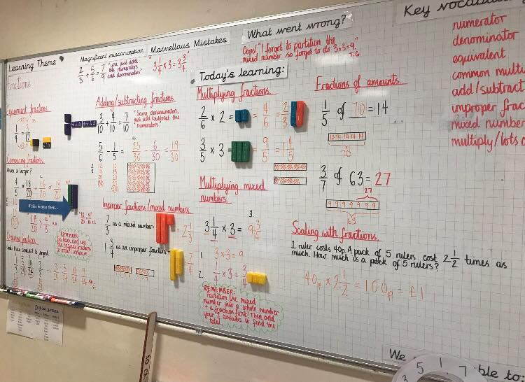
The Use of Working Walls to map our learning journey through a block
and aid recall and retrieval of key learning points.

