Slide 1

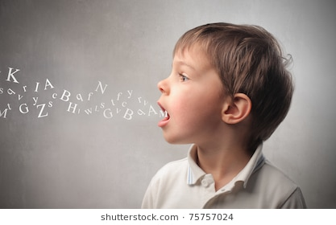
Eloquent and Truthful

Slide 2
Gathering
Listen to this song as you come together
https://www.youtube.com/watch?v=zeCwwaciAA8

Slide 3
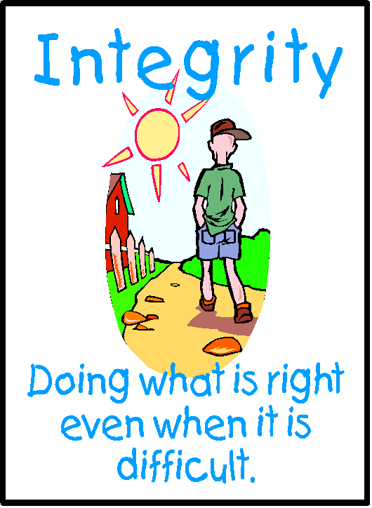
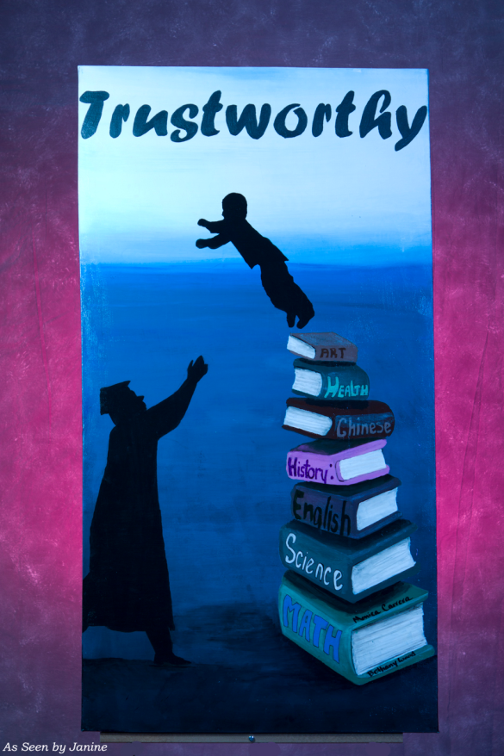
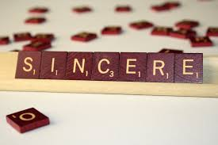
What does it mean to be truthful?

Slide 4


What does it mean to be Eloquent?
Expressive, Articulate, Fluent, Meaningful

Slide 5

The boy who cried wolf
https://www.youtube.com/watch?v=-DRS8DR0Rck

Slide 6
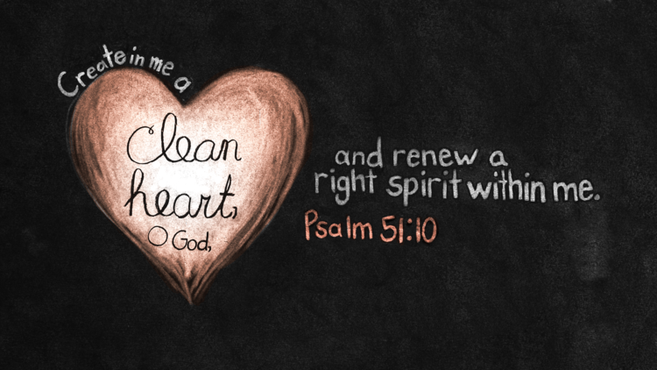
Let us pray
Lord,
Please help me to always tell the truth.
Send your Holy Spirit to guide me so that I may make right choices.
If I am tempted to do wrong, please help me to listen to my conscience.
Please forgive me for the times when I have been dishonest.
Amen

Slide 7
Mission
Let’s see if we can help each other to do these things
Think before we speak.
Tell the truth even when it’s hard.
Help others to be truthful by listening to them carefully.
Try to explain how we are felling so others can understand us.
Be understanding if others find it hard to be truthful.

