Slide 1
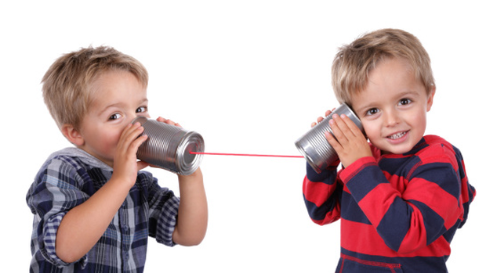

Eloquent and Truthful

Slide 2
Gathering
Listen to this song as you come together
https://www.youtube.com/watch?v=8ZeylcI25Lw

Slide 3
Can you remember what it means to be truthful and eloquent?

Slide 4
Debate our point of view
Ask questions
Express emotions
We need the
language to:
Speak beliefs
Engage in conversation
Talk about faith and hope

Slide 5

BUT…
Being able to speak well is no use if what we speak is not the truth.
Eloquence must be used in a truthful way.

Slide 6
Peter Preaches
While you watch this video notice how the Holy Spirit helped Peter spread the message of Pentecost to people from all over the world.
https://www.youtube.com/watch?v=hKa9jqvJ378

Slide 7
Let us pray
Lord,
Help us to be eloquent in what we say but also in our writing, in our dancing, in our art and in our sport. Show us the importance of speaking the truth about ourselves and others, about the world and about God. Help us to search the truth to set us free to see clearly and grow as individuals.
Amen

Slide 8
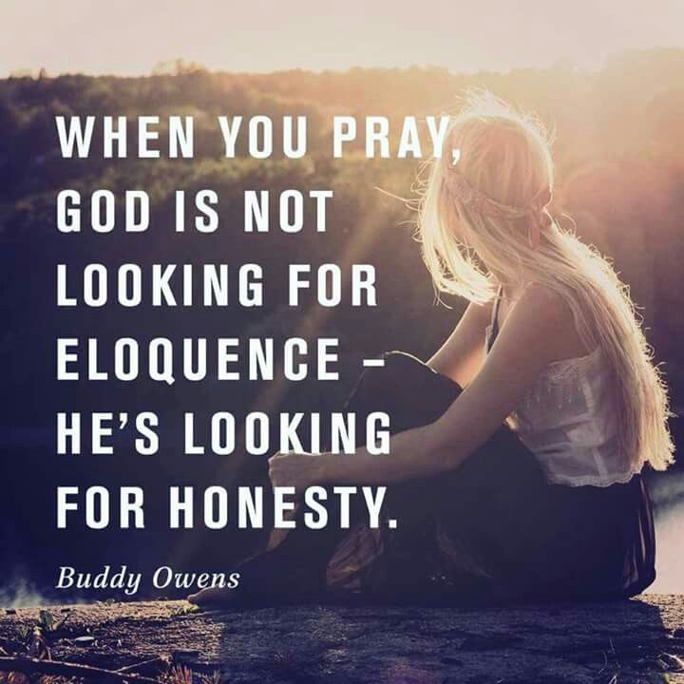
Mission
Be eloquent in our prayer.
When we say a prayer we know by heart try to think of the words we’re saying.
When we are talking to God in prayer remember that he will listen to us however disjointed, being truthful in our prayer will make it eloquent.

