Slide 1
As we gather: Watch https://www.youtube.com/watch?v=5IlVfkY5q54
Play up to 1:15 (skip adverts) as the children enter the sacred space and fade out.

Slide 2
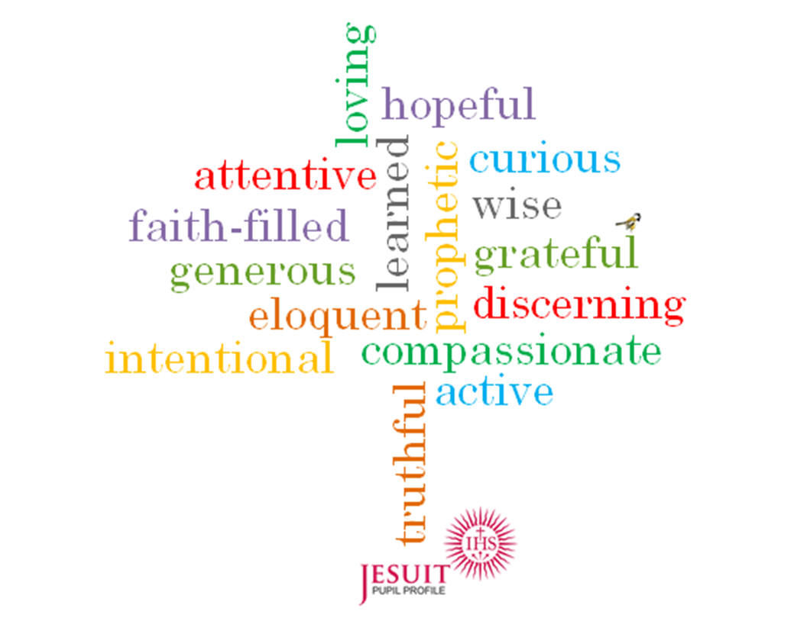
Learned and Wise

Slide 3
Let us say our Morning Offering.
What does it mean to be Learned and Wise?
To put it simply, to be ‘learned’ (pronounced ‘learn-ed’) means to be educated and knowledgeable.
What do we learn at school?
Can you think of subjects or topics that we learn about?
What is your favourite subject at school?
How can you be a good learner?

Slide 4

Jesus Christ is at the centre of our school.
We learn about the wonderful world we live in and the human beings, plants and animals which God created.
We learn the language of other countries because we are all God’s people.
God wants us to learn and grow to become the best we can be.

Slide 5
Let us listen and watch God’s word, from which God wants us to learn.
https://www.youtube.com/watch?v=OxOCvNwbZTY
In this video we see that God’s word needs to be listened to properly. We should learn from God’s word and live it out from our heart.

Slide 6

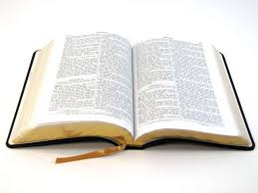

Response to God’s word
Let us close our eyes for a moment and think about how we can follow God’s word in our every day actions and in the way that we treat others.
How can we show that we have learned from the Word of God?
Where can we hear or read God’s word?

Slide 7
Let us pray for God’s help as we learn.
Lord, as we go to our work each day
Help us to take pleasure therein
Show us clearly what our duty is,
Help us to be faithful in doing it
May all we do be well done, fit for thine eye to see.
Give us enthusiasm to attempt, patience to perform
When we cannot love our work
May we think of it as your task
And make what is unlovely beautiful through loving service
For thy name’s sake.
Amen

Slide 8

Our Mission
We will listen and learn from God’s word.
We will live out God’s word in all that we say and do.
We will strive to do our best in the work we do.

