Slide 1
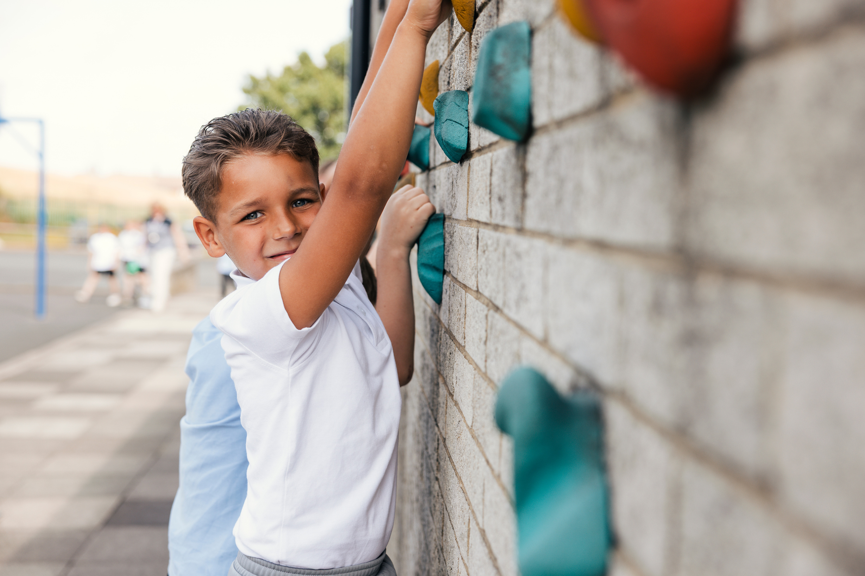
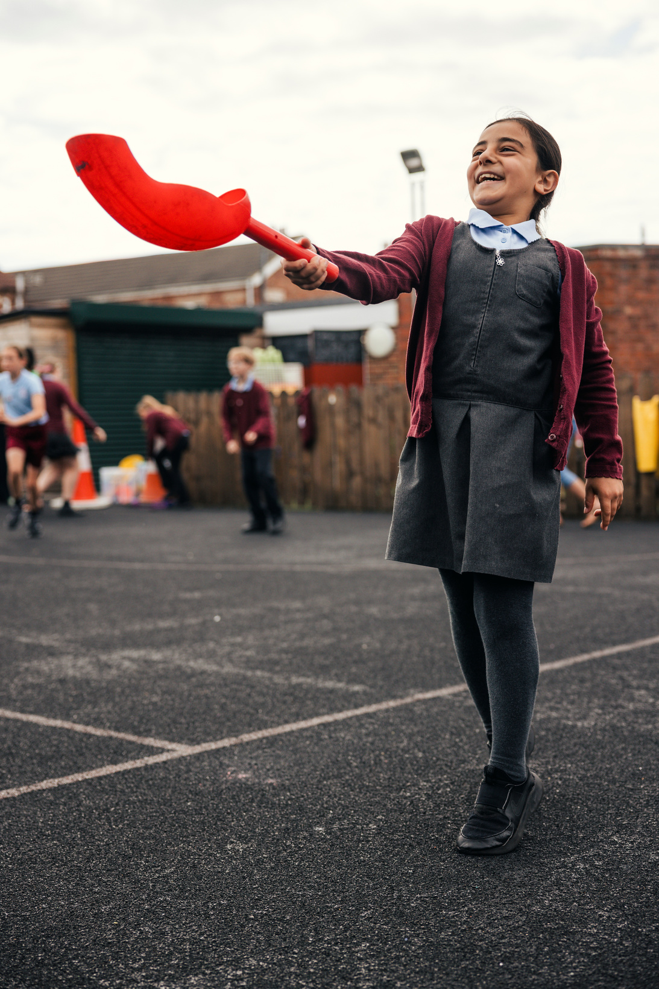

Part A
PE and Sport Premium transition toolkit
Monitoring form
2026/27 academic year

Slide 2
Part A PE and sport premium transition toolkit
Monitoring form
It is intended that this monitoring form should be used as preparation for the completion of the statutory DfE PE and sport premium digital expenditure reporting return. You can upload data (including swimming) from this template onto this platform once it becomes accessible.
The template is a working document that you can amend and up during the year.
Before you decide how you are going to use the funding for this academic year you should reflect and evaluate the impact of your use of your PE and sport premium funding in 2026/27.
You should use your evaluation of last year’s funding to help you decide what to do this academic year, how you will do it, and what impact you expect it to have.
All spending of the funding must conform with the terms outlined in the conditions of grant
The summative digital expenditure reporting form includes swimming and water safety information. PE and sport premium funding can be used to provide top-up lessons following the completion of core-swimming lessons where necessary, to ensure pupils meet national curriculum swimming requirements
To ensure funding is used effectively and based on your school’s needs; guidance and examples of best practice across schools can be found here.
You must use the funding to make additional and sustainable improvements to the PE and sport in your school.
You must develop and add to the PESSPA activities that your school already offers.
Useful Links:
PE and sport premium for primary schools - GOV.UK
PE and sport premium: conditions of grant 2026 to 2027 - GOV.UK
The grant also supports the Inclusion 2024 Inclusive PE hub an online platform of resources to help schools make PE and sport more inclusive.
Swimming and Water Safety

Slide 3
Review of the last academic year (2025/2026)
Swimming and Water Safety | What went well? Supporting evidence? | What didn't go well? Supporting evidence?
1. Swim competently, confidently and proficiently over a distance of at least 25 metres | 96.7% of pupils in year 6 can swim 25 metres. Evidenced on Swimming assessment tracker based on information and data collected poolside with swimming teacher. This was an increase from last year as we took children who hadn’t met the standard for an additional 7 sessions with an extra instructor. | We are aiming for this to be 100%, so targeted sessions for those pupils not meeting expectations. Evidenced on Swimming assessment tracker based on information and data collected poolside with swimming teacher.
2. Use a range of strokes effectively (for example, front crawl, backstroke and breaststroke) | 80% of pupils in year 6 can use a range of strokes effectively. Evidenced on Swimming assessment tracker based on information and data collected poolside with swimming teacher. Selected children who were confident were able to represent the school in a swimming gala. | We are aiming for this to be 100%, so targeted sessions for those pupils not meeting expectations with a focus on EAL children. Evidenced on Swimming assessment tracker based on information and data collected poolside with swimming teacher.
3. Perform safe self-rescue in different water-based situations | 64% of pupils in year 6 can perform safe self-rescue. Evidenced on Swimming assessment tracker based on information and data collected poolside with swimming teacher. | We are aiming for this to be 100%, so targeted sessions for those pupils not meeting expectations with a focus on children with EAL. Evidenced on Swimming assessment tracker based on information and data collected poolside with swimming teacher.

Slide 4
Review of the last academic year (2025/2026)
Key areas as outlined in PE and sport premium guidance | What went well? Supporting evidence? | What didn't go well? Supporting evidence?
1. Increase all staff’s confidence, knowledge and skills in teaching PE and sporting activities | Complete PE delivered a whole day training session for staff with a focus on dance and OAA as these were identified as areas teachers were less confident with. On a scale of 1 – 5, the average confidence level across teachers has gone from a 3 to a 5 after the training. Stride Active delivered a session on teaching gymnastics skills as this was identified as an area of staff concern in a survey. Since the training, confidence levels have gone from an average of 3 to a 5. Pupil voice data suggests children feel as though they are making progress in all PE lessons. Children stated that they are fun, they develop new skills and they use a range of equipment. Children enjoy their teachers teaching them. End of year data shows that 89% of children are meeting the expected standard for their age group, with 11% of those exceeding. | Staff now feel confident with teaching dance, OAA and gymnastics. We would now like to focus on teachers developing their knowledge of key skills in addition just games. The number of children exceeding is currently 11%. Although we are happy with this as it is our first year using Complete PE, we would like this to increase to 20% this year.
2. Increase all pupils’ engagement in regular physical activity and sporting activities | All pupils in Year 4, 5 and 6 participated in at least one sporting activity outside of school during the course of the year. All children in KS2 have the opportunity to play in the active zone at lunch time which involves 30 minutes of competitive sport. 80% of children said they play in this zone at least once a week. Playground Pals lead the younger children in physical activity which also involves the leaders becoming active themselves. We had 10 Playground Pals who supported each week. Physical activity and sporting achievements are celebrated in assemblies throughout the year. | Not all pupils are active for 60 minutes a day, 7 days a week. Not all children in KS1 engaged with the Playground Pals. More children in Year 6 would benefit from becoming Playground Pals to boost their leadership skills. Not all children took up the opportunity to participate in an after school sports club.

Slide 5
Review of the last academic year (2025/2026)
Key areas as outlined in PE and sport premium guidance | What went well? Supporting evidence? | What didn't go well? Supporting evidence?
3. Raising the profile of PE and sport across the school, to support whole school improvement | By celebrating all things sport related we are encouraging more pupils to enjoy movement and physical activity. Children in Year 5 and 6 were given the opportunity to attend a women’s wheelchair basketball match after school. This was done to target girls and promote disability sport. Links to clubs outside of school time are regularly promoted in our school bulletin to boost the number of children achieving their 60 active minutes a day. Children in Year 6 attend an enrichment morning at Bishops Meadow where they were able to try out lots of different sports and were made aware of some facilities that would be free to them on the weekend in the hope to encourage them to attend with their families. | Not all pupils are active for 60 minutes a day, 7 days a week. Not all parents are able to take their child to clubs outside of school time. After school sports clubs are not used by all children.
4. Offer a broader and more equal experience of a range of sports and physical activities to all pupils and ensure equal access to sport for boys and girls | Continuing to offer a wider range of activities both within and outside the curriculum to get more pupils involved: All sporting clubs in school are open to both boys and girls and there is an equal take up from both genders. Outside providers have given the children to develop their skills further in dance and football. We used matches and competitions against other schools to encourage children to attend after school clubs. | Not all pupils are active for 60 minutes a day, 7 days a week. The dance club is only made up of 13% boys despite it being widely promoted to both genders.
5. Increase participation in competitive sport | 100% of all pupils have taken part in an intra house competition at the end of relevant units and during sports day. 60% of KS2 have taken part in an Inter competition. | Continue to develop our competition provision. We need a bigger drive to ensure all pupils in KS1 have an opportunity to participate in competitive sports.

Slide 6
What are your next steps for this 2026/27 academic year?
Aim | Why? | Key Area | Supporting evidence
Focus on teacher training ensuring all teachers are confident to enjoy teaching high-quality Physical Education with a specific focus on skills. | To ensure 100% of pupils are participating in two hours a week of high-quality PE every week. | Increasing confidence, knowledge and skills of all staff in teaching PE skills and sporting activities; prioritising CPD and training where needed. | Staff confidence surveys, pupil attainment data, lesson observation reviews, pupil voice.
Provide in school opportunities for pupils to access multiple opportunities to be physically active and monitor external physical activity to drive physical activity levels with key focus groups. A particular focus to be on active learning. | To ensure that 100% of pupils will be active on average 60 minutes a day, 7 days a week. | Key Indicator 2: Increasing engagement of all pupils in regular physical activity and sporting activities | External physical activity trackers outlining the amount of activity pupils' access outside of school. Extra curricular timetable and participation data. Lunchtime participation data, alongside lunchtime activity plan. Data for all physical activity level tracked on Complete PE’s PA assessment.
Provide regular intra school competition, as well as all pupils accessing inter competitions against other schools. Competition formats to reflect needs of pupils. See school games offer | To ensure 100% of pupils in KS2 can access competition in school and outside of school, to encourage all pupils to participate and enjoy these valuable experiences. | Key indicator 5: Increasing participation in competitive sport | Competition formats and planning for all intra lesson level competitions, all inter competitions hosted at our school and sports day. City schools competition package for tournaments and event. . Competition calendar and register of participants.
Focus on top-up swimming and water safety for those pupils not achieving the expected swimming and water safety attainment. | To ensure 100% of pupils meet the expected swimming targets. | Key Indicators 1, 3, 4. Developing pupil attainment. | Evidenced on Swimming assessment tracker based on information and data collected poolside with swimming teacher.

Slide 7
PE and school sport checklist
Consider within your school where you currently stand and what further support you need to put in place.
Questions | Yes | Partly | No
Do you have a clear PE and school sport action plan for the year ahead (2026/27), agreed by leadership?
Can you evidence how last year’s PE and sport premium funding was spent, and what difference it made?
Do you know what Physical Education looks and feels like in your school and is this delivery high-quality?
Is there a clear plan to develop staff confidence in PE, whether delivery is internal, external or mixed?
Do you have a curriculum that is broad, progressive and properly sequenced across year groups?
Do you know how many pupils are active for at least 60 minutes a day, 7 days a week?
Do you have a clear plan for your extra-curricular club offer?
Is your wider school sport offer, including competitions, festivals, and fixtures planned?
Do you have effective data collection systems in place to record and evidence that swimming and water safety provision is on track to meet national curriculum requirements ?
Do you have a clear plan for encouraging SEND pupils and less active pupils to become more active and participate in PE and school sport?
If a governor, trust lead or external reviewer asked to see your PE and sport plan for future development, would you have clear evidence and rationale for impact?
Are you clear on existing links with local clubs, and community settings to identify where further support and engagement could be made using local support for enhance your provision?

Slide 8
Aims for the next academic year (2026/2027)
Using your whole school priorities, school development plan and previous PE, school sport and physical activity data, set out your aims for the year ahead.
Think about specific areas of need such as inactive girls, SEND and disadvantaged pupils
Remember to also input your swimming data and reflections in the table located at the bottom of this page.
Consider which of the 5 key areas improvements will be focusing on:
increase all staff’s confidence, knowledge and skills in teaching PE and sporting activities
increase all pupils’ engagement in regular physical activity and sporting activities
raise the profile of PE and sport across the school, to support whole school improvement
offer a broader and more equal experience of a range of sports and physical activities to all pupils, and ensure equal access to sport for boys and girls
increase participation in competitive sport
Please aim to use this as a live working document through the year.
Keep returning to this to evidence adaptations and progress made through the PESSPA opportunities you provide.
There is no set number of objectives you must have.
Make as many or as few as you see fit that will support your aims for the year ahead

Slide 9
Plan, monitor and evaluate (2026/2027)
Swimming and water safety
Questions | Yes | Partly | No
Do you have effective data collection systems in place to record and evidence that swimming and water safety provision is on track to meet national curriculum requirements ?
Will any of your year 6 group be accessing top up swimming to enable them to achieve the outcomes below?
Look at the attainment of your current year 6 cohort. Complete by July 31, 2027.
Swimming and Water Safety | What went well? Supporting evidence? | What didn't go well? Supporting evidence?
1. Swim competently, confidently and proficiently over a distance of at least 25 metres
2. Use a range of strokes effectively (for example, front crawl, backstroke and breaststroke)
3. Perform safe self-rescue in different water-based situations

Slide 10
Plan, monitor and evaluate (2026/2027)
Provide CPD and support to all staff
 | Intent - what is your objective? | Implementation - How will you achieve this? | Impact - What do you hope to see? | Supporting evidence
Plan and monitor (Complete now and monitor) | Focus on teacher training ensuring all teachers are confident to enjoy teaching high-quality Physical Education. | Quality of teaching and learning in Physical Education will be developed through bespoke staff CPD for all class teachers. CPD will be delivered by Stride Active and Complete PE. Ensure scheme of work annual membership is paid to ensure teachers can access High-Quality planning and supporting resources. PE resources updated to enable High-Quality teaching to take place. | Staff confidence in January 2026 showed a variety of confidence levels at teaching key skills within the NC. We predict that by July 2027, 100% of staff will feel confident in teaching all areas of the curriculum. By July 2027 we predict that all teachers will have been trained and that 100% of all lessons being delivered will be ‘high quality’. Pupil voice data from Summer 2026 shows children enjoy PE lessons and have the equipment that they need. By the end of July 2027 pupil voice should show pupils and learning and developing new skills that they can use at a competitive level. Those achieving GDS will rise from 11% to 20% and those achieving EXP will rise from 89% to 100%. | Staff confidence surveys, pupils' attainment data, lesson observation reviews, pupil voice.
 | What impact have you seen? | Are the improvements sustainable? How? | Supporting evidence | Approx. cost
Evaluate (to be completed by July 2027) |  |  |  | £150 bespoke teacher CPD in school £200 additional courses £550 scheme of work annual membership £500 updated resources Total = £1400

Slide 11
Plan, monitor and evaluate (2026/2027)
Drive physical activity levels
 | Intent - what is your objective? | Implementation - How will you achieve this? | Impact - What do you hope to see? | Supporting evidence
Plan and monitor (Complete now and monitor) | Provide in school opportunities for pupils to access multiple opportunities to be physically active and monitor external physical activity to drive physical activity levels with key focus groups. Therefore, ensure that all pupils will be active on average 60 minutes a day, 7 days a week. | Increase the number and range of activities and clubs on offer (Pupil Led Games, after school club, games, dance. Parent and child fitness club.) Implementation of new extra-curricular timetable. Develop provision for physical activity at lunchtime by increasing the amount of playground resources to provide playground activity facilitated by lunchtime supervisors and Year 6 Playground Pals Equipment and resources to be purchased for facilitation of activity with Playground Pals and independent active play. Use leadership ideas from scheme of work and Stride Active. Lunchtime supervisors have a bank of ideas from a previous Stride Active session. | In July 2026, only 70% of the school were active for 60 minutes a day, 7 days a week. We aim to achieve 100% of children being active for 60 minutes a day by July 2027 through the continuation of the active zone and new extra curricular opportunities. We are aiming for 90% of pupils to be active at lunchtime through Playground Pals and the active zone. We are aiming boost to the take up of after school clubs by increasing our offer. | External physical activity trackers outlining the amount of activity pupils’ access outside of school. Extra curricular timetable and participation data. Lunchtime participation data, alongside lunchtime activity plan. Data for all physical activity level tracked on Complete PE PA assessment.
 | What impact have you seen? | Are the improvements sustainable? | Supporting evidence | Approx. cost
Evaluate (to be completed by July 2027) |  |  |  | £500 new equipment for lunch times and extra curricular clubs. £1000 extra curricular instructors Total = £1500

Slide 12
Plan, monitor and evaluate (2026/2027)
Develop competition
 | Intent - what is your objective? | Implementation - How will you achieve this? | Impact - What do you hope to see? | Supporting evidence
Plan and monitor (Complete now and monitor) | Ensure all pupils can access competition in school through regular intra school competition, as well as all pupils accessing inter-school competitions against other schools. See school games offer. | Arrange KS1 multi skills session, potentially look at linking with another school to do this. Participate in events offered in the Stride Active’s competitions package such as netball and multi skills. Arrange house competition within classes to take place at the end of each unit to celebrate learning. Arrange all UKS2 to represent school through school games competitions and competition hosted here against other local primary schools. | 100% of KS1 to have participated in a competitive sports fixture. . Through new KS2 competitions and opportunities we expect 100% of children to participate in inter house tournaments. 100% of all pupils will compete once again in an intra-house competition at the end of relevant units and during sports day. | Competition formats and planning for all intra-school lesson level competitions, all inter competitions hosted at our school and sports day. Competition calendar and register of participants.
 | What impact have you seen? | Are the improvements sustainable? How? | Supporting evidence | Approx. cost
Evaluate (to be completed by July 2027) |  |  |  | £200 for medals and other resources to inspire children to complete.

Slide 13
Looking ahead and sustainability
(Example is for reference purposes only)
Intent - what is your objective and why? | Implementation - How will you achieve this? | Impact - What do you hope to see? | Potential cost? | What supporting evidence will be necessary? | Is this sustainable, or does it require a year-on-year commitment
Continue to provide CPD to ensure consistently high-quality PE lessons. | PE lead to continue attending Stride Active training to be able to provide ongoing support and training in-house. | Continued high-quality practice, maintaining impact data evidence mentioned above. | £150 | Staff confidence surveys, pupil attainment data, pupil voice, learning walks, staff professional development plans. | Sustainable.
Focus on lunchtime provision to maximise the offer so all pupils can participate. | Develop further midday supervisor and play leader training to increase the variety of active opportunities accessible to all pupils at lunchtime. | Maintain the activity level at lunchtime of 90% and / or exceed these. | £300 | Pupil activity level, pupil voice, pupil engagement. | Sustainable.
Develop an OAA course so we can offer a cross curricular approach and push active learning | Speak to organsiastions who offer this and get quotes for a map to be designed. | Active learning across all subjects and OAA used across the curriculum | £3000 | Pupil activity level, pupil voice, pupil engagement, teacher voice. | Sustainable

