Slide 1
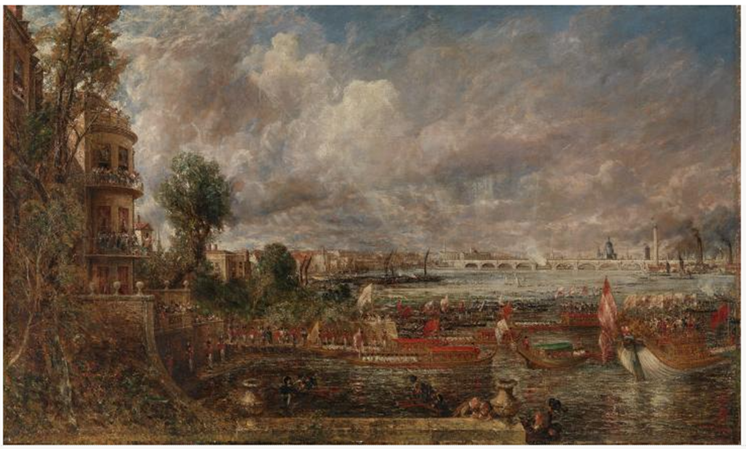
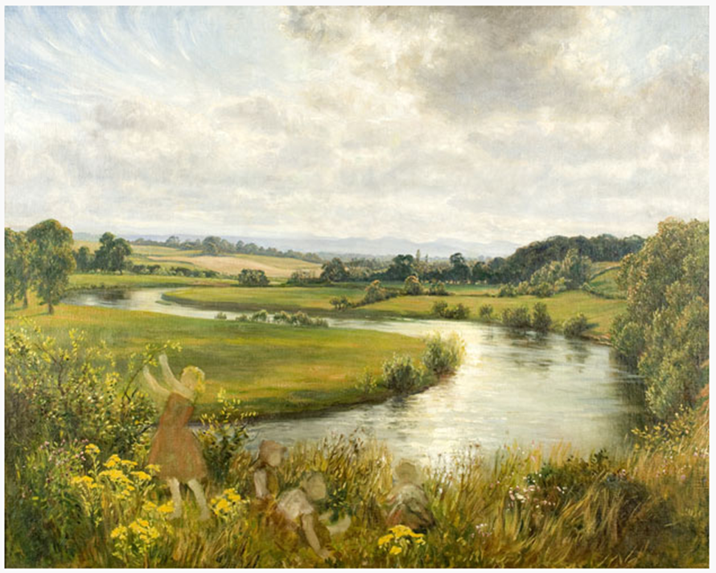
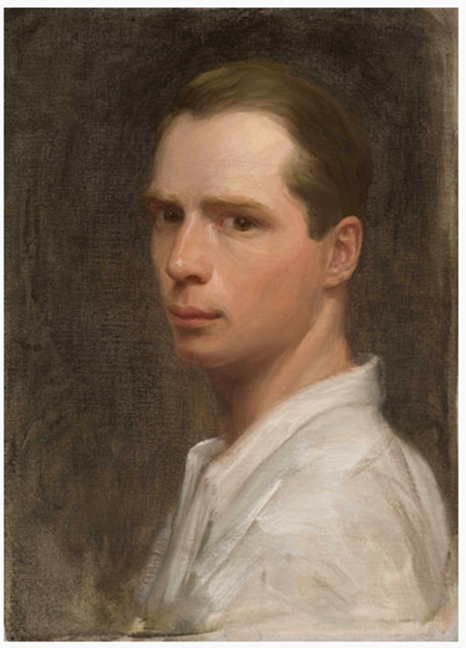
Year 6
Art and Design
Spring Term 2
Keywords:
Perspective, horizon line, vanishing point, lines of perspective, light shade, linseed oil, landscape.
Local Artist: Brian Hatton
Fine Artist: John Constable
Medium: Oil Painting
Landscapes and Perspective
Over seven feet in length, this is the largest of Constable’s exhibition canvases and the result of thirteen years of planning. It commemorates the opening of Waterloo Bridge - and the second anniversary of the Battle of Waterloo - on 18 June 1817, an occasion celebrated with tremendous pomp and ceremony which Constable attempted to recapture in a whole series of drawings and oil sketches, dating from 1819 onwards.
Brian Hatton: During his life, he created over 1000 art works including, oil paintings, watercolours, and pencil and pastel drawings, together with a small number of prints. His subjects included: landscape views, horses and other animals, agricultural activities and country people.
The opening of Waterloo Bridge 1817 by John Constable

